Slide 1
Design and development of sustainable and automated irrigation system based on multi-depth sensor fusion mechanism
ESPC 2023 Project Presentation
Indian Institute of Technology Palakkad
Authors
Adithya Rajeev Anjali CV
SrikarEmany Sreehari V
Mentors
Dr. Sreenath V, Asst. Prof. Dept. of Electrical Engineering
Dr. Satyajit Das, Asst. Prof. Dept. of Data Science
1/12/2023

Slide 2
Content
Introduction
Overview
Methodology
Test Setup
Multi-depth Sensor Fusion
IDW Spatial Interpolation
Automated Irrigation Controller
Conclusions
‹#›

Slide 3
Motivations
Irrigation is a crucial factor of Agriculture. Managing this critical resource sustainably and environmentally is crucial.
Farmers need access to cutting-edge agricultural technologies for enhanced yield & efficient production.
Farmers face numerous challenges, ranging from water scarcity to labor-intensive practices.
Affordable technology to ensure that even small farms may profit from its potential.
Objectives
Automated irrigation for water conservation, eliminating man labor & efficient water discharge.
Enhancing accuracy of soil moisture measurement using Spatial Interpolation technique.
Solar-powered irrigation system for Standalone operation.
Optimal resource utilisation and thereby avoiding plant stress.
‹#›

Slide 4
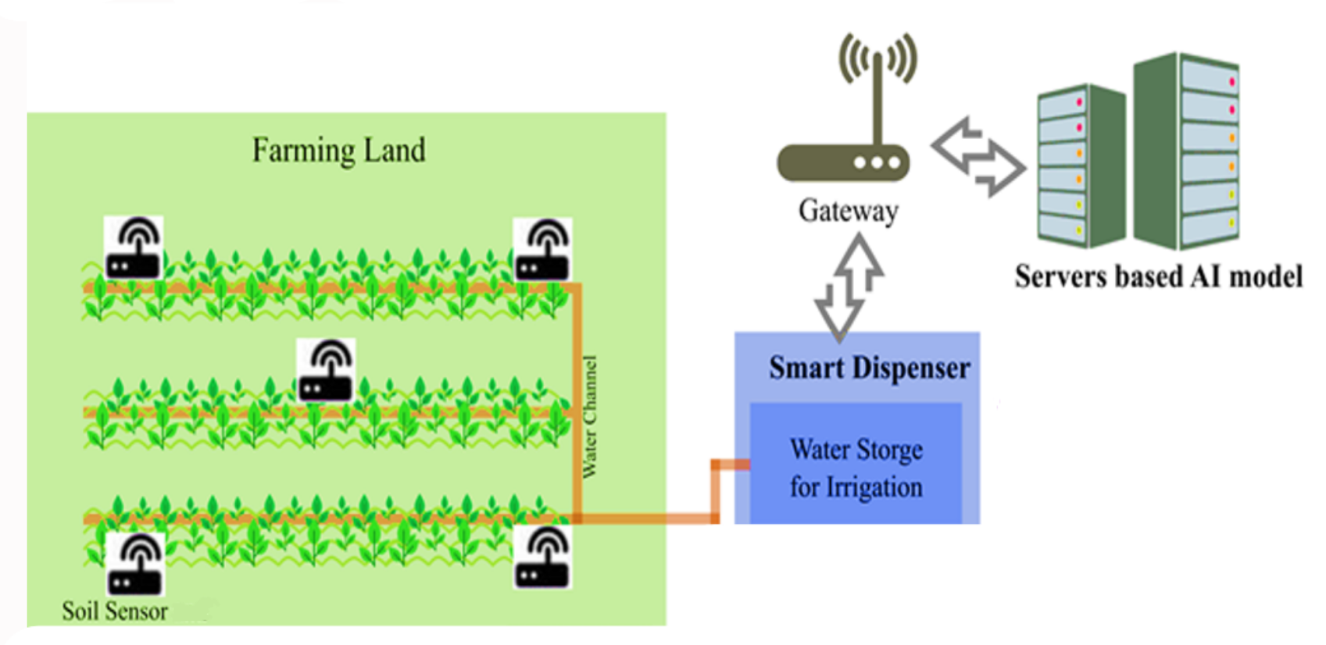
Overview
Installation of Multi-depth moisture sensors
Obtaining moisture data from these sensors.
Spatial Interpolation in QGIS to predict moisture distribution.
Feeding the moisture data to Automatic Irrigation Controller.
Flow-sensor based irrigation cutoff when the required water quantity is reached.
Fig 1. Block diagram representation of the proposed project.
‹#›

Slide 5
Methodology
Test Setup
15 Cent test plot
- Divided into 4 subplots
Installed multi depth soil moisture sensors at 4 corners and 1 at centre of the plot
Indigenously Built automated Irrigation Controller
Inverse Distance Weighted (IDW) Spatial Interpolation
Flow sensors & Control Valves
Fig 2. Installed drip irrigation system at test plot at IIT Palakkad.
‹#›

Slide 6
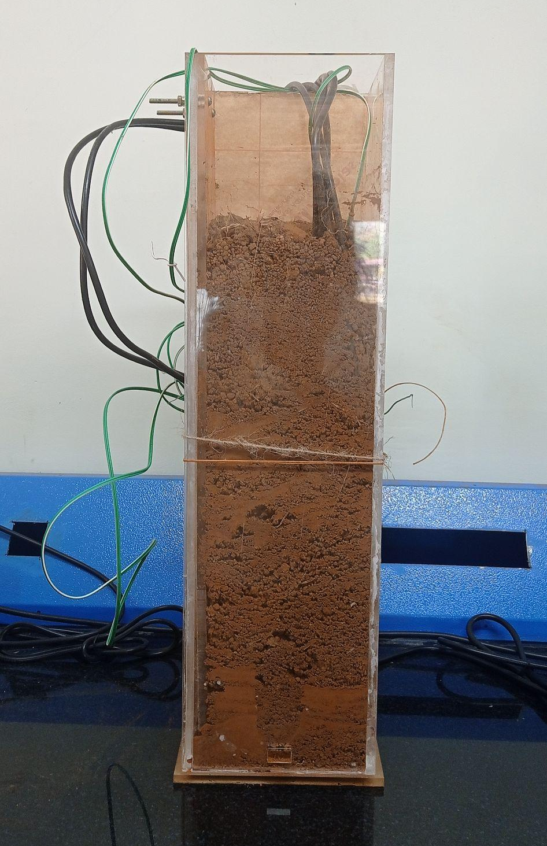
B. Multi-depth Sensor Fusion
Primary and Secondary Soil moisture sensors installed at 15cm and 30cm depth.
The correlation of this data from multi-depth sensors are a novel approach and predicts water requirement based on soil profile.
Fig 3. Multi-depth moisture sensors in the field and the lab test setup.
‹#›

Slide 7
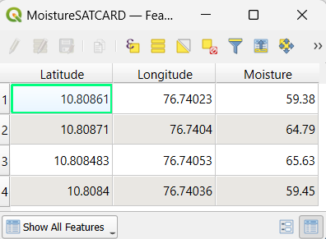
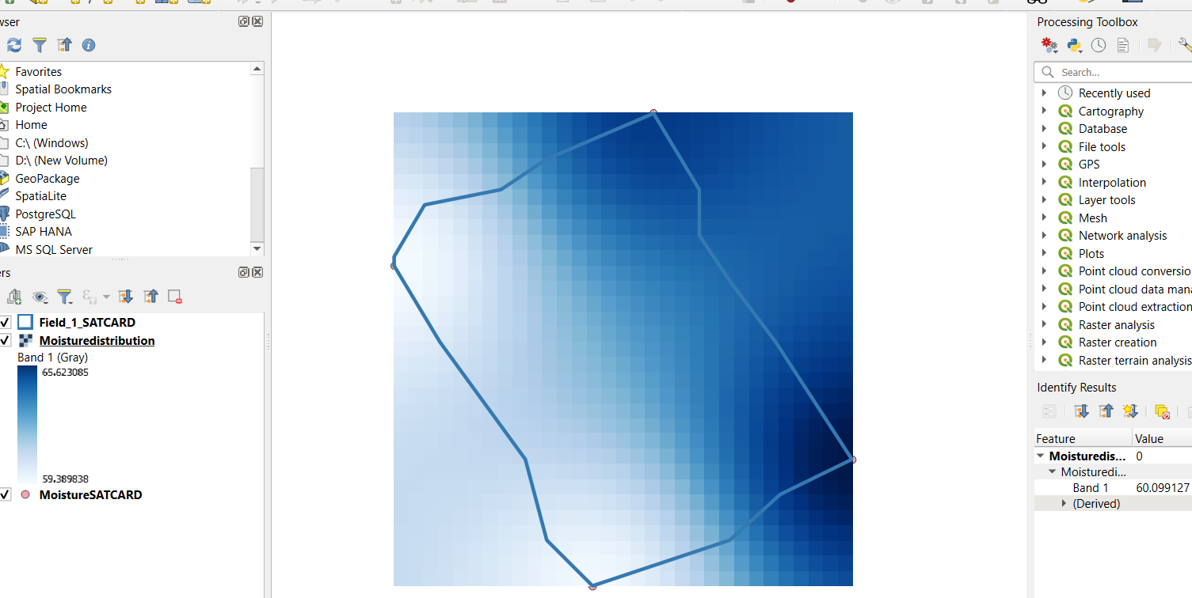
C. Inverse Distance Weighted (IDW) Spatial Interpolation
Performing Spatial Interpolation to get the moisture distribution of the entire 15 cent plot.
The two values are interpolated to get the water requirement based on the vertical root zone area moisture distribution.
Feeding the water requirement of each subplot to the Control System.
Fig 4. Moisture data fed to QGIS software & interpolation results.
‹#›

Slide 8
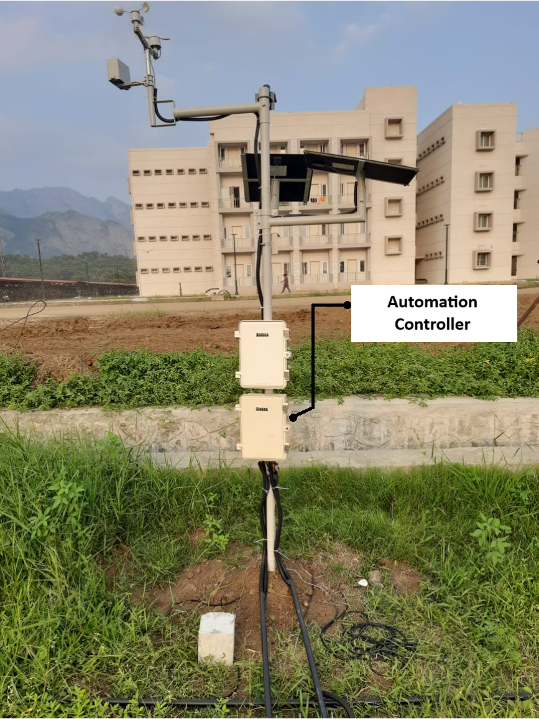
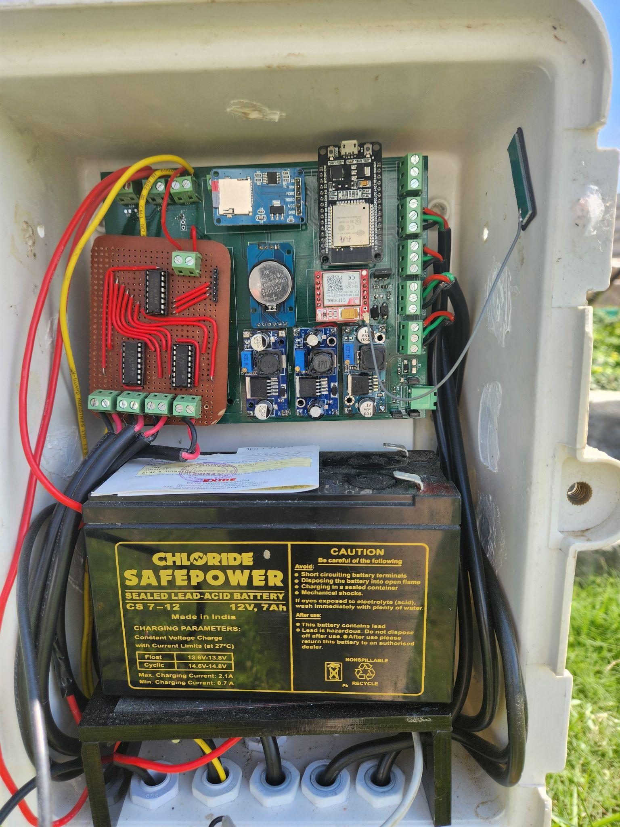
D. Automated Irrigation Controller
ESP32 based Standalone Drip Irrigation unit that works on Pre-set Start time
Starts the DC pump and Valves of respective subplots in consecutive manner
The flow to each subplot stops when the water requirement is met (data from Flow sensor)
Irrigation
Control Unit
Control Lines
Fig 5. Control unit mounted on Weather station unit pole at the test field.
‹#›

Slide 9
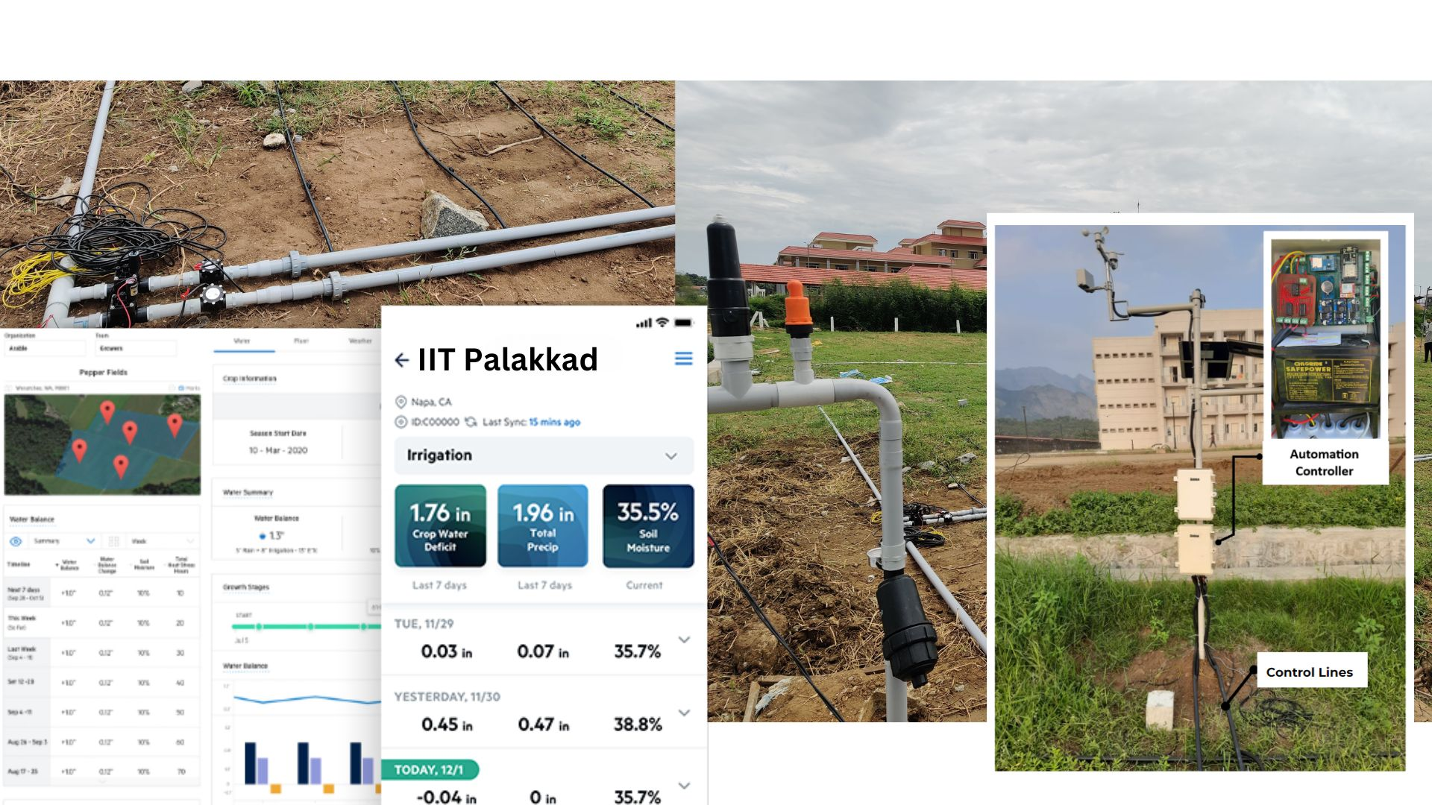
Prototype developed and deployed at IIT Palakkad
‹#›

Slide 10
Conclusions
Novel automated irrigation unit with interpolation technique based on multi-depth soil moisture sensor mechanism.
Efficacy improvisation as per tests conducted in lab and field deployment.
Efficacy increase with integration of software based spatial interpolation.
Reduced water requirement and optimal utilisation for effective irrigation.
PATENT (drafted) Smart integration of Multi-depth sensor fusion mechanism and spatial interpolation technique for predictive analysis of soil moisture distribution over the vertical and horizontal soil profile, Adithya Rajeev, Anjali CV, Srikar Emany, Sreehari V, Sreenath V
Future Scope
Optimising sensor node deployment without compromising on affordability and reliability for wide scale applications.
Estimation of evapotranspiration for accurate irrigation scheduling.
Conducting field trials to fine-tune the system with farmer feedback.
‹#›

