Slide 1
Environmental Sensing Project Competition(ESPC-2022) SENSING AND CAPTURING THE GASEOUS STATE OF CARBON THROUGH NOVEL BIO CATALYTIC RESISTIVE SENSOR
Presenters
1. M S Sudhir Narayana
2. N Vignesh
3. G Samar Simha Reddy
4. T Fabio Mughilan
Supervisors
1. Dr. R Gowri Shankar Rao
2. Dr K R Aswin Sidhaarth

Slide 2
Objective
It is seen that in our heavily industrial world that selective detection of gases is of utmost importance.​
There are several types of sensors that already exist, but they are expensive and are complex in operation.​
The objective is to create a set-up that senses the gases, specifically CO₂, with leaf-extracts as a catalyst.

Slide 3
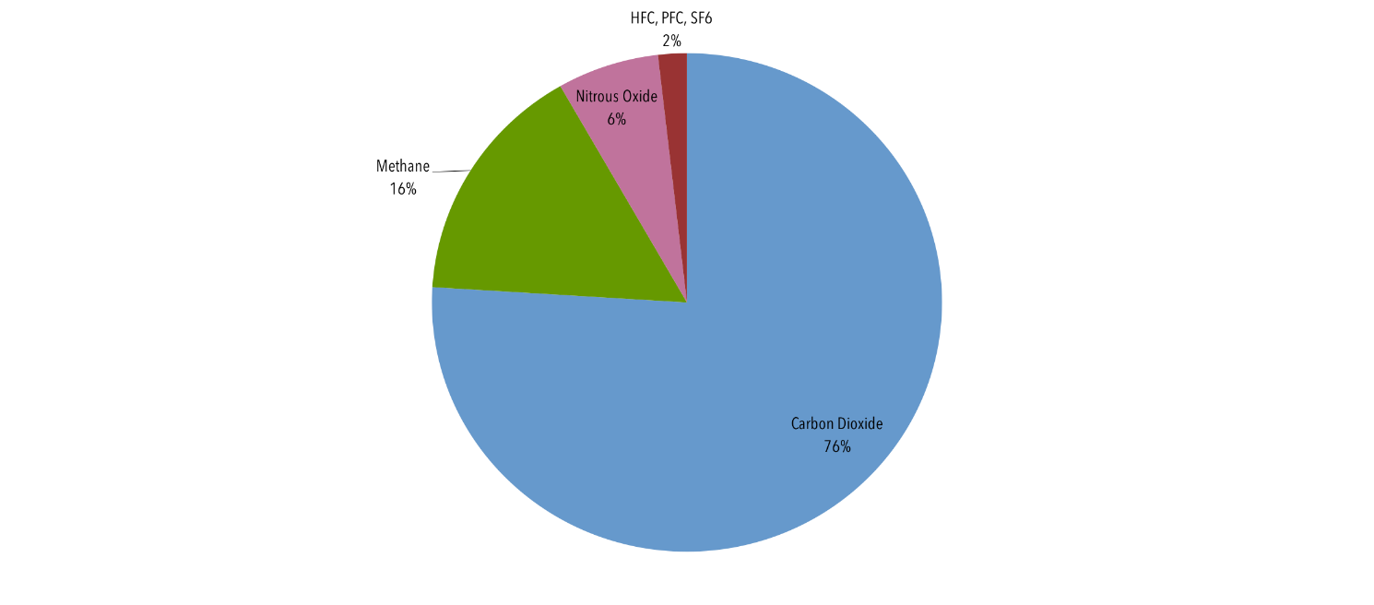
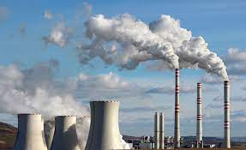
Primary Sources Of Green House Gases
Sources of greenhouse gas emissions are electricity and heat (31%), agriculture (11%), transportation (15%), forestry (6%) and manufacturing (12%). Energy production of all types accounts for 72 percent of all emissions.

Slide 4
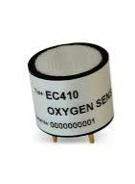
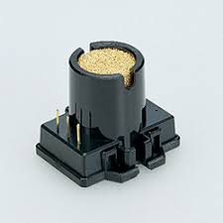
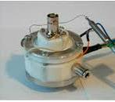
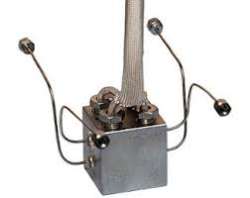
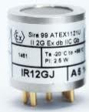
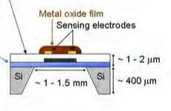
Different types of gas sensors with different transduction forms have been developed
Catalytic combustion gas sensor
Electrochemical gas sensor
QCM gas sensor
Thermal Conductivity gas sensor
Infrared Absorption Sensor
Resistive gas sensor

Slide 5
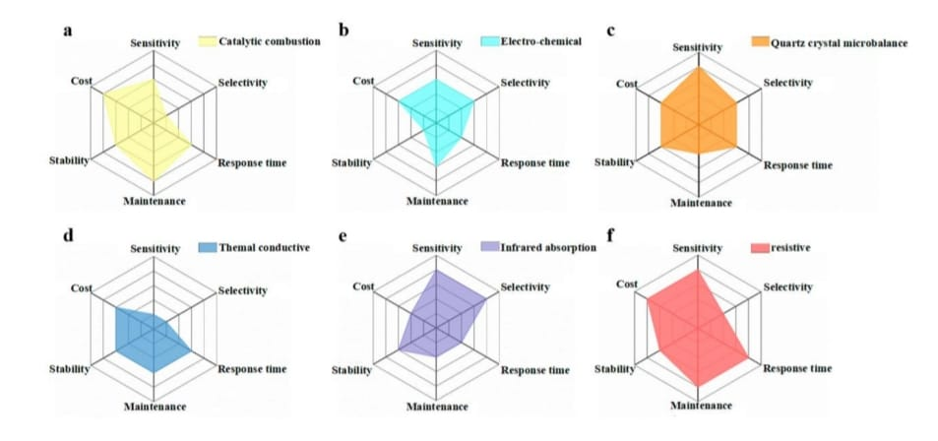
The Spider-Web Graph shown below Illustrates Properties of Different types of Sensors

Slide 6
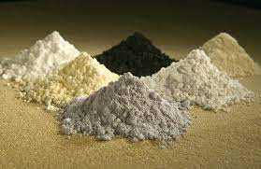
Plant Extract Based Sensor
Present Composition Of Sensors
Cost Efficient
Metal Oxides

Slide 7
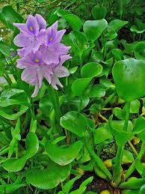
Plants Used
Water Hyacinth (Eichhornia crassipes)
Sacred fig
(Ficus religiosa)
Indian bael
(Aegle marmelos)

Slide 8
Research Gap
The present Sensors uses non-biodegradable materials
It is expensive and manufacturing process is tedious .
It also involves Complex Operation.
Hence the attempt is taken to develop novel Bio-Catalytic Sensor for sensing and capturing atmospheric CO_{2.}

Slide 9
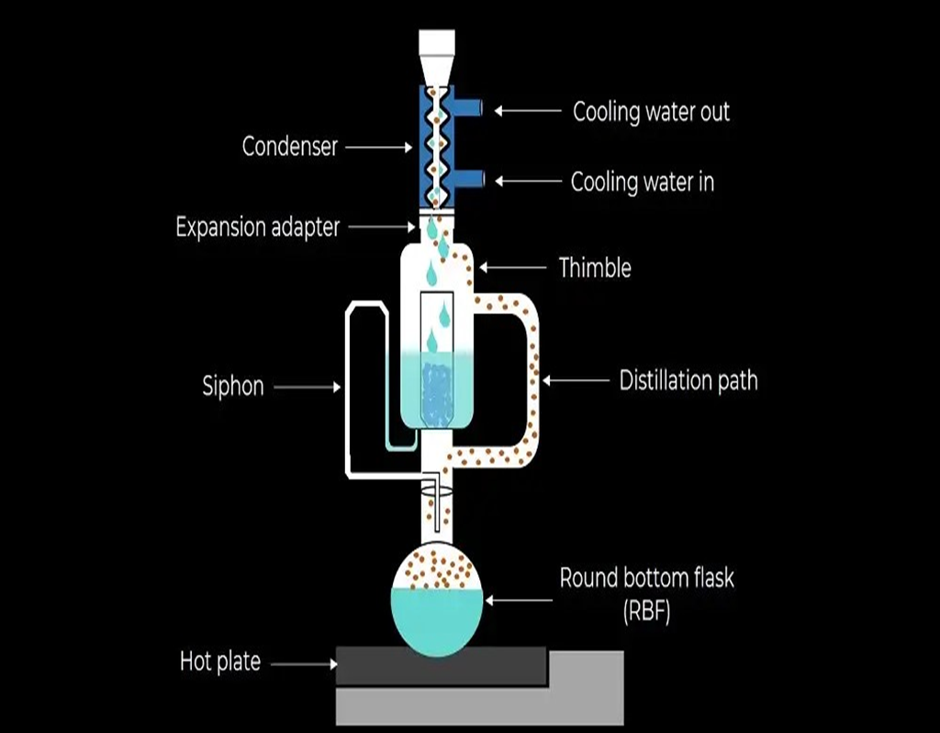
Methodology-Extraction Using Soxhlet Apparatus

Slide 10
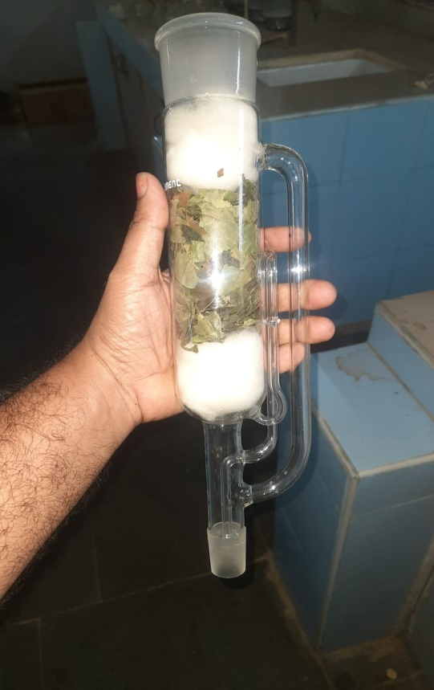
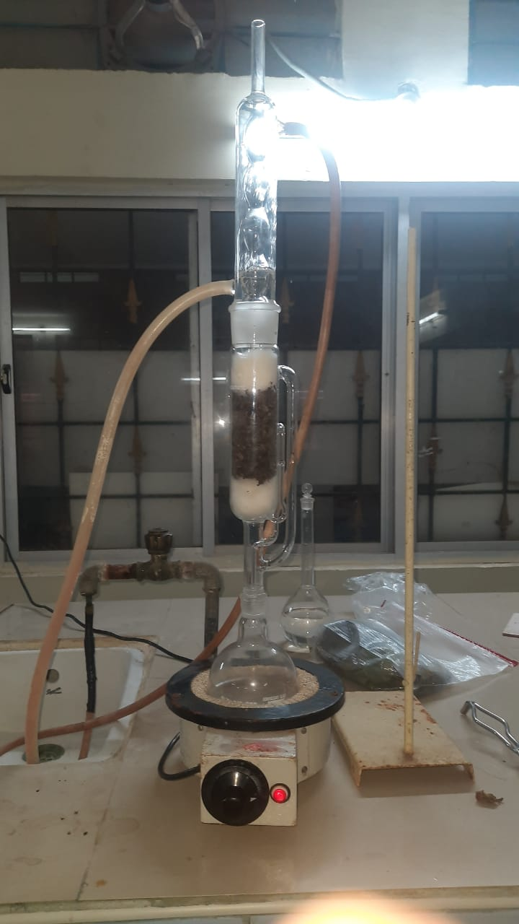
Filling with Dried Leaves in Soxhlet Apparatus

Slide 11
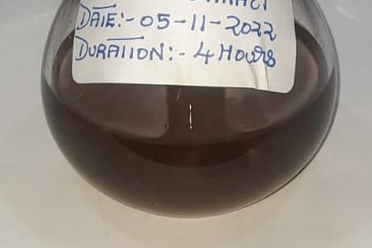
Extracts
Sample 1
Sacred Fig
(Ficus religiosa)
Sample 2
Water Hyacinth
(Eichhornia crassipes)
Sample 3
Indian bael
(Aegle marmelos)

Slide 12
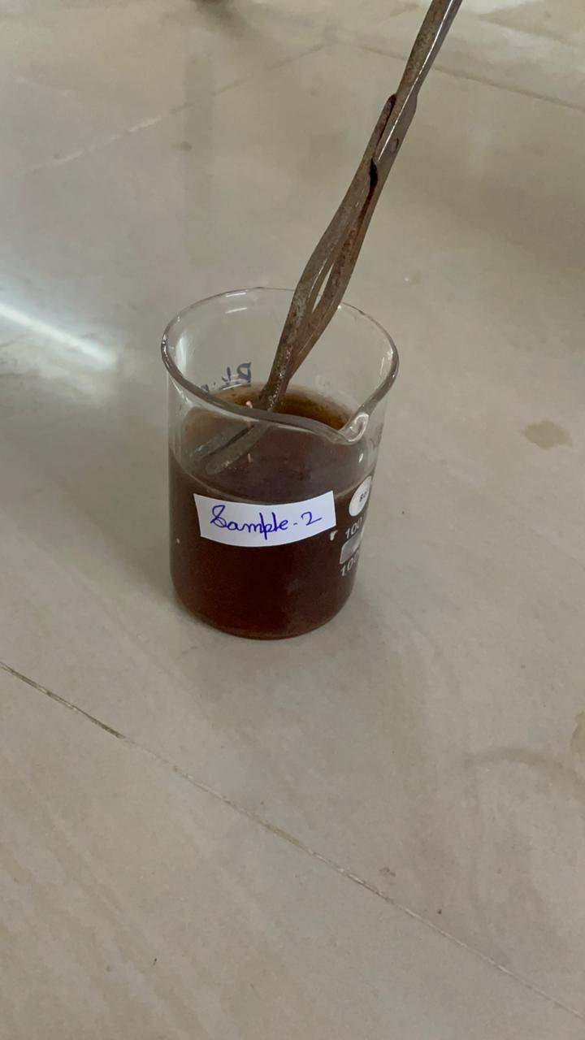
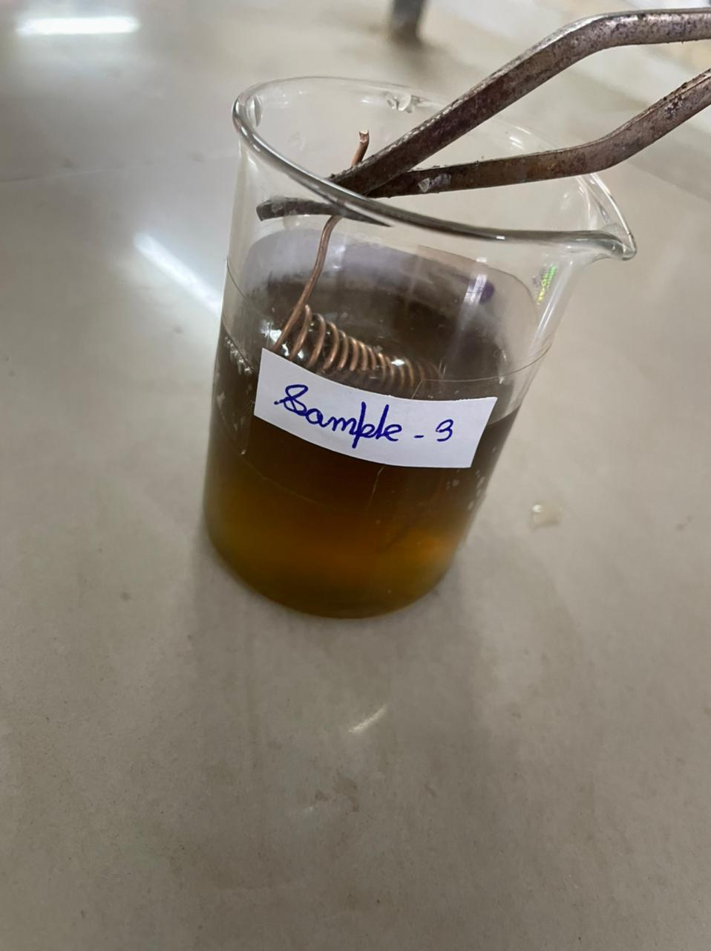
Coating Copper Coil with the Obtained Extracts

Slide 13
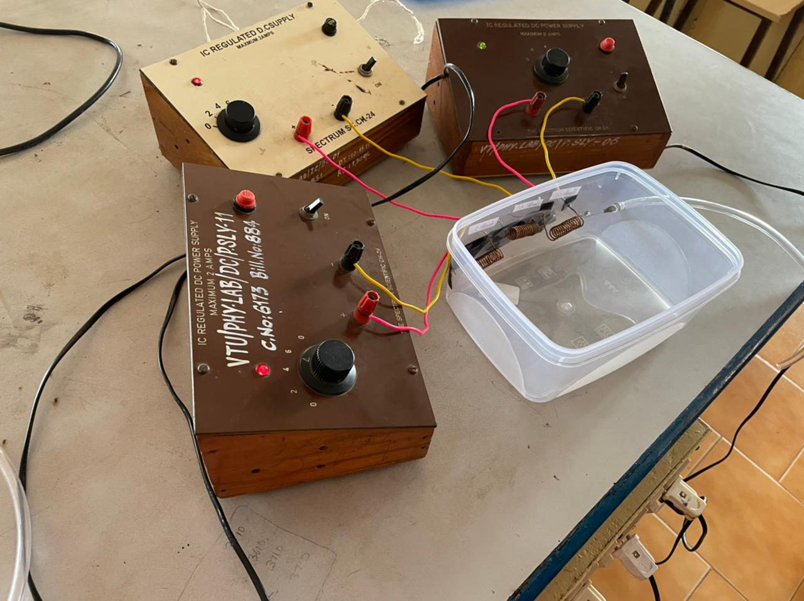
Hardware Setup Arrangement

Slide 14
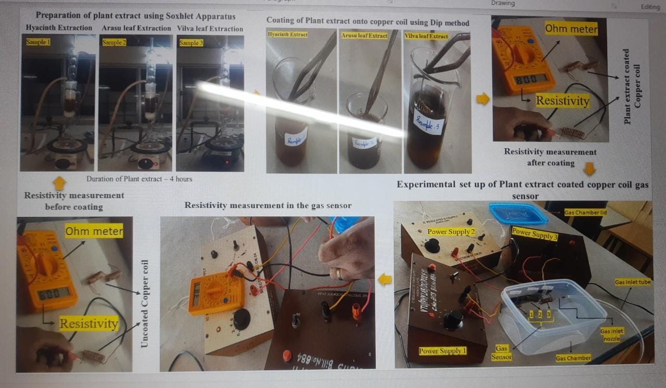

Slide 15
Results:-Resistance Values Before And After Passing CO₂

Slide 16
Conclusion
The proposed sensor configuration can be used for the detection of CO₂ gas. The system is designed to meet the maximum absorption in the near surface.
Future Work
Plant Extract based Resistive Sensor will be developed for the capture of carbon dioxide gas
Further mechanisms will be developed in terms of energy storage.

Slide 17
References
1. Ze Wang , Lei Zhu , Shiyi Sun, Jianan Wang and Wei Yan, One-Dimensional Nanomaterials in Resistive Gas Sensor: From Material Design to Application. Chemosensors, 2021,9, 1-32.
2. Ali Mirzaei, Jae-Hyoung Lee, Sanjit Manohar Majhi, Resistive gas sensors based on metal-oxide Nanowires. J. Appl. Phys.2019, 241102-1 - 241102-24.
3. Liqun Wu 1 , Ting Zhang 1 , Hongcheng Wang 1,*, Chengxin Tang 2 and Linan Zhang, A Novel Fabricating Process of Catalytic Gas Sensor Based on Droplet Generating Technology, Micromachines, 2019, 10, 1-11.
4. Yingying Jian , Wenwen Hu , Zhenhuan Zhao , Pengfei Cheng , Hossam Haick, Mingshui Yao, Weiwei Wu, Gas Sensors Based on Chemi‑Resistive Hybrid Functional Nanomaterials, Nano Micro Letters, 2020, 1-43

